Slide 1
Driver Development
BQ2741

Slide 2
Objective
Write code for the BQ2741 Battery Fuel Gauge
Assumptions
We have I2C driver with read/write functions
Agenda
Discuss I2C bus operation
Review Driver/Library Abstraction
Review Datasheet
Write code

Slide 3
I2C Bus
Developed by Philips Semiconductor (now NXP) in 1982
System Management Bus (SMBus) defined in 1995 is subset of I2C.
Use to require license fee, hence to avoid license chips used “Two Wire Interface” instead of calling it I2C, as of 2006 no license fees.
Can be use as multiple masters and/or multiple slaves
Each slave has to have independent address
Address collision can happen, check your hardware
Uses two wires
SCL – Clock
SDA – Data

Slide 4
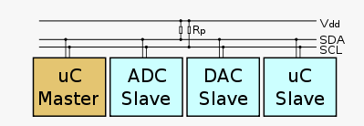
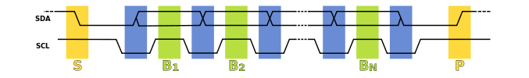
I2C Bus
Shared bus with open collector (open drain) outputs
Requires pull up on the SDA/SCL pins
Three control signals
Start
Repeat Start
Stop
Slave can Acknowledge (ACK) or Not Acknowledged (NACK) a byte
Slaves can hold clock low to extend timing.
Physical (PHY) layer

Slide 5
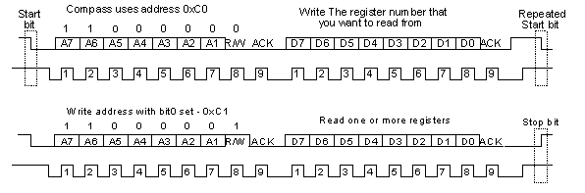
I2C Bus Details
Start bit
Address
Read/Write
ACK
Data
Repeat Start/Stop bit
Data Link Layer

Slide 6
I2C Addresses
7-bit verse 8-bit
If address for write is 1100 0000
Is the slave address
8-bit 0xC0 - 1100 0000
7-bit 0x60 - 0110 0000
I2C spec uses 7bit addresses
Some people use 8bit
Best to define as:
0xC0 – write, 0xC1 – read
1100 000r/w
Generally if address does not work, try shifting it by 1 bit.

Slide 7
I2C Problems
If you are in the middle of clocking out data and reset processor, what happens?
If there is noise on the bus and chip detects start bit what happens?
These often result in master and slave out of sync or chip locking up.
I2C spec says if you send 9 clock pulses with SDA high the chip should reset.
Many chips do not do this.
For high availability devices you often need a way to hard reset I2C chips (power cycle them).

Slide 8
Driver Abstraction
We often use a directory structure in our projects like:
Source
Drivers
I2C
Libraries
Does the BQ2741 go under drivers or libraries?
It is up to you, generally I personally like drivers to be chip peripheral drivers
Then libraries to be code you might use on another processor
As such I would put in libraries, but you are open to do it the way you want.
It does not matter how you organize your code, it matters if you do or not.

Slide 9
Driver Abstraction
Our drive will have the following abstraction layers
Application Code
Fuel Gauge Functions (% battery charge)
BQ2471 Driver
Read/Write Values (temperature, volts)
Read Write Registers
I2C Driver
I2C Layer
Foundation
SYSLOG
Delay
TIME

Slide 10
Good Code Guidelines
Functions should do one thing and one thing only
No side effects – setting a global variable is a side effect
If function is doing two things, make it two functions
Generally if function is larger than can be seen on screen, break it up into multiple functions.
Do not repeat yourself, if you are writing the same code, make it a function.
To keep from being overwhelmed start simple, and build up or down.
If you have a problem that is hard to code, consider a state machine approach. You will know it when this happens.
When you have error use the ERROR() macro to report.
Check return codes from functions.
Validate your inputs!

Slide 11
Driver Creation Steps
First we need to know commands to read/write data to I2C
Read the datasheet, twice.
You will not understand the datasheet, this is normal
You will start understanding when you start testing code, this is normal
Create an abstraction of chip
This allows us to support multiple chips on one board
Abstract register addresses used in chip to names
Create read/write functions for registers in chip

Slide 12
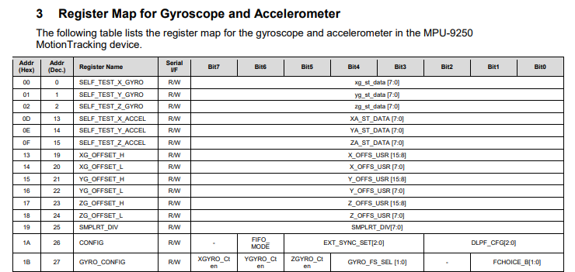
Register Based Chips
Most Chips (I2C, SPI, etc) operate on a register basis
A register is a memory location that contains a value.
This is how most chips and peripherals work

Slide 13
BQ2471 Registers
The BQ2471 uses a register map but calls things a little different
Their ‘register map’ is called a commands.
The commands are for reading values
Additionally they have a secondary ‘register map’ for control settings
The control settings change how fuel gauge works.
Datasheets
http://www.ti.com/lit/ds/symlink/bq27421-g1.pdf
http://www.ti.com/lit/ug/sluuac5c/sluuac5c.pdf

Slide 14
I2C Driver
A common interface for the I2C driver is through the code below.
It will be assumed for the BQ2741 we will have similar functions
bool init(Pin pin_scl, Pin pin_sda, uint32_t speed);
bool set_speed(uint32_t speed);
size_t write(uint8_t slave_7bit_address, bool stop_bit, uint8_t *ptrData, size_t count);
size_t read(uint8_t slave_7bit_address, bool stop_bit, uint8_t *ptrData, size_t count);

Slide 15
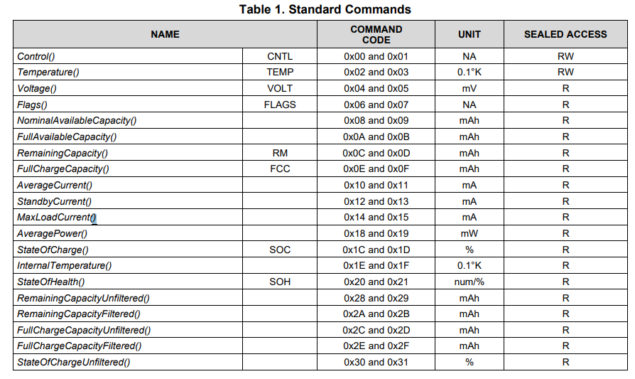
BQ2471 Commands
Each Command holds a 2 byte value
Hence two addresses
We can abstract register using #defines, but I prefer enums
typedef enum {
CNTRL =0x01,
TEMPERATURE = 0x02,
VOLTAGE = 0x04,
FLAGS = 0x06,
//....
}BQ2741_Commands_t;;

Slide 16
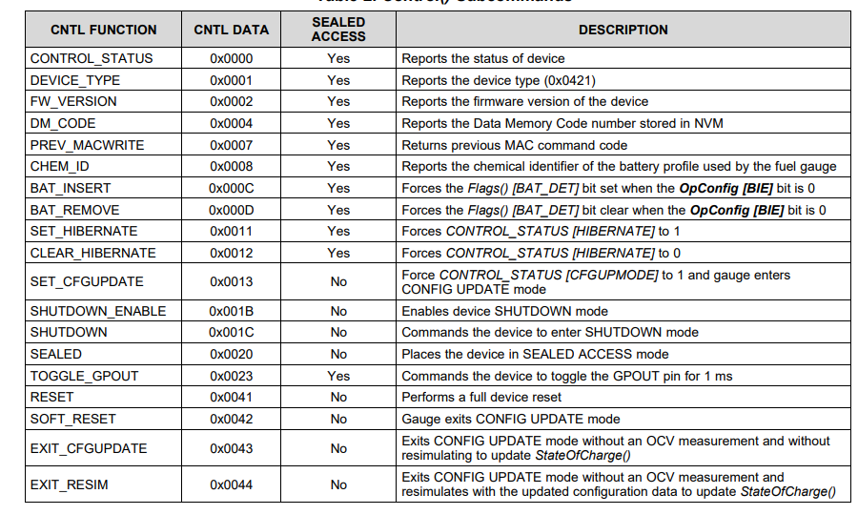
BQ2741 Interface
typedef enum {
CONTROL_STATUS=0x0000,
DEVICE_TYPE=0x0001,
FW_VERSION = 0x0002,
DM_CODE = 0x0003,
//.....
}BQ2741_Registers_t;
BQ2741 has control functions as well We need to abstract these registers
We can do it with #define
I prefer to use enums
It creates a data type
Which helps compiler check for errors
#define BQ2741_CONTROL_STATUS (0x0000)
#define BQ2741_DEVICE_TYPE (0x0001)

Slide 17
Initialization code
What if we have two BQ2741 chips connected?
A good driver will be abstracted so it can be use with multiple chips
The structure below holds all data needed to know which chip is being used.
Could include which I2C bus is being used
typedef struct {
uint8_t address;
}BQ2741_t;
bool init(BQ2741_t *ptrChip, uint8_t address)
{
ptrChip->address=address;
return true;
}

Slide 18

BQ2714 I2C data
A write to register looks like:
A Read looks like:

Slide 19
Read Command
static bool _read_command(BQ2741_t *ptrChip, BQ2741_Commands_t reg, uint16_t *ptrValue)
{
uint8_t data[2];
size_t ret;
data[0]=(uint8_t)reg;
//do not send stop bit
ret=write(ptrChip->address, false, data,1);
if (1 != ret)
{
ERROR("Could not write register 0x%0X ",reg);
return false;
}
//send read request
ret=read(ptrChip->address, true, data,2);
if (2 != ret)
{
ERROR("Could not read register 0x%0X ",reg);
return false;
}
*ptrValue=((uint16_t)data[0])<<8 | data[1];
return true;
}

Slide 20
Write Control
static bool _write_control(BQ2741_t *ptrChip, BQ2741_Control_t control, uint8_t value)
{
uint8_t data[4];
size_t ret;
data[0]=(uint8_t)CNTRL;
data[1]=(uint8_t) (control>>8);
data[2]=(uint8_t) (control & 0x00FF);
data[3]= value;
ret=write(ptrChip->address, true, data,4);
if (4 != ret)
{
ERROR("Could not write register 0x%0X to value 0x%0X",control,value);
return false;
}
return true;
}

Slide 21
Read Control
static bool _read_control(BQ2741_t *ptrChip, BQ2741_Control_t control, uint8_t *ptrValue)
{
uint8_t data[3];
size_t ret;
data[0]=(uint8_t)CNTRL;
data[1]=(uint8_t) (control>>8);
data[2]=(uint8_t) (control & 0x00FF);
//do not send stop bit
ret=write(ptrChip->address, false, data,3);
if (3 != ret)
{
ERROR("Could not write control 0x%0X ",control);
return false;
}
//send read request
ret=read(ptrChip->address, true, data,1);
if (1 != ret)
{
ERROR("Could not read control 0x%0X ",control);
return false;
}
*ptrValue=data[0];
return true;
}

Slide 22
Where From Here?
Test the functions
Now that we can read/write the control and commands we can write higher level functions.
Grow up to application
Test each level as you go
Use the Internet to see how things have been done before
Application Code
Fuel Gauge Functions (% battery charge)
BQ2471 Driver
Read/Write Values (temperature, volts)
Read Write Registers
I2C Driver
I2C Layer
Foundation
SYSLOG
Delay
TIME

Slide 23
Problems and Code Review
The above code should not pass a code review.
What if the pointer to the BQ2741 was null?
The parameters that are constant does not have const attribute.
Checking Null Pointer can be done several ways:
static bool _read_control(BQ2741_t *ptrChip, BQ2741_Control_t control, uint8_t *ptrValue)
{
uint8_t data[3];
size_t ret;
if (NULL==ptrChip)
{
ERROR(“Pointer to chip is NULL”);
return false;
}
assert(ptrChip);

Slide 24
assert
assert is used to assert something to be true (not false)
assert only runs on debug builds
Captures programming errors during debug, not runtime errors
I often create my own ASSERT() macro
#define ASSERT(x) {if(!(x)){ERROR(#x); assert(!#x);} }
This will print and error, and assert with string for error
You can change how macro behaves on release builds
For example reset processor after logging error
Or try to continue operation, etc.

Slide 25
Good Habits
Use const where applicable
Use assert()
Always print ERROR() when you return error from function
Do comparisons with constant on left side
Make sure the correct warnings and errors are enabled on your compiler
If (ptr = NULL) …. Is valid and can trigger an error or warning if enabled
At least with GCC
If ( NULL = ptr) … would fail to compile on every compiler.
Write code to be portable to other processors

